Slide 1


CONTENT
1. Show results of Lab 04 Step 49 & Step 50 2. AWS Architecture - Diagram 3. AWS Academy & MC & IAM Role 4. Data Storage – S3 bucket with file 5. Data Warehouse – Redshift Settings 6. Redshift Cluster (Security Group) 7. Redshift Cluster (Create Table) 8. Redshift Cluster (Load Project Data) 9. Redshift (Preview Data) 10. Redshift (Queries on total & max) 11. Tableau – Live Data Connection 12. Tableau – Live Data Synchronization 13. Tableau (Table Display) 14. Data Visualization 1 – three Charts 15. Data Visualization 2 – Dashboard 16. Project Hours/Cost
17. demonstration video
Group Assignment
Fang Sen
s4650134
G2 Wirth
Demonstration video

Slide 2
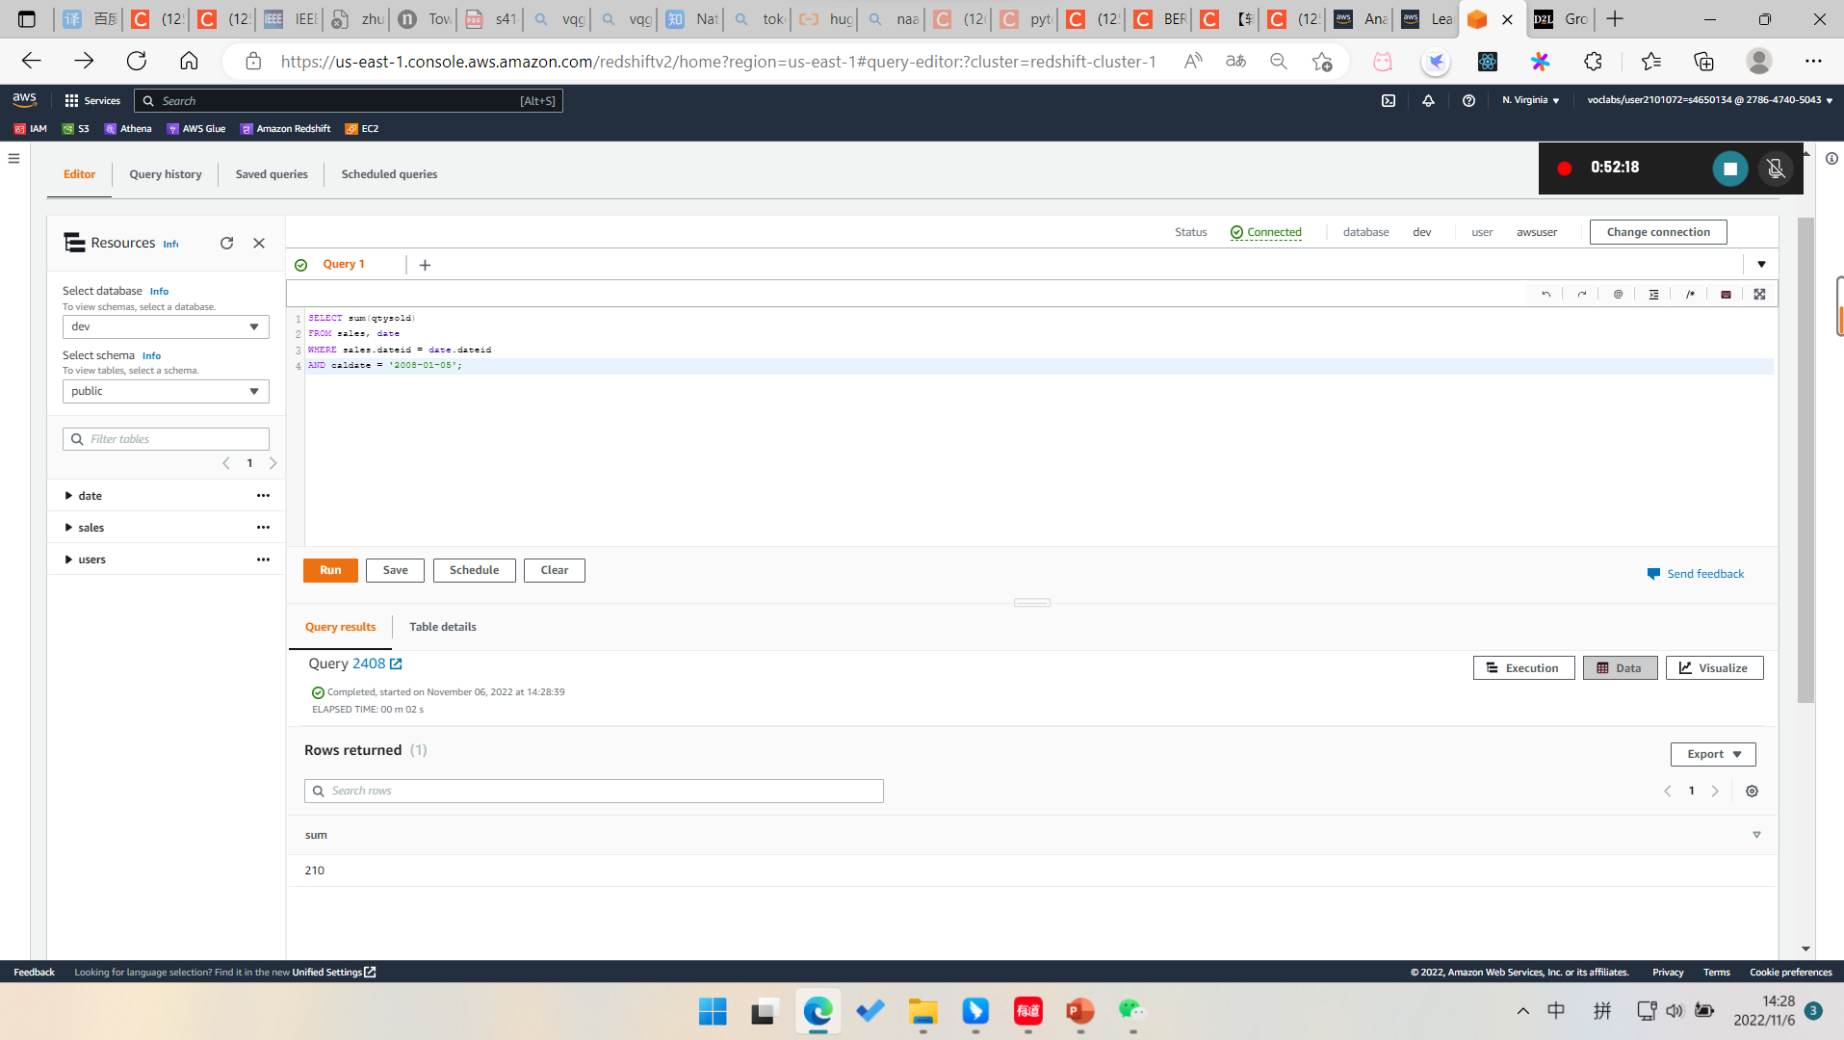
Results of Lab 04 Step 49

Slide 3
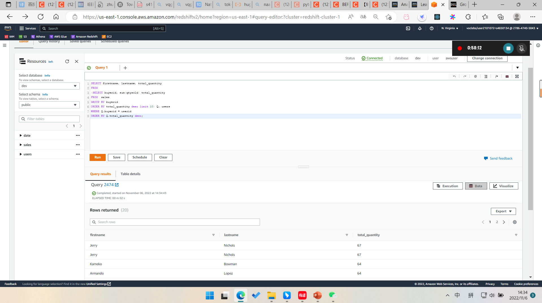
Results of Lab 04 Step 50

Slide 4
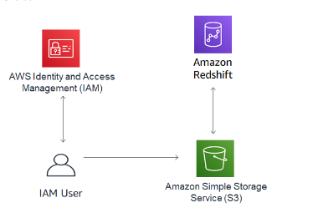
AWS Architecture - Diagram

Slide 5
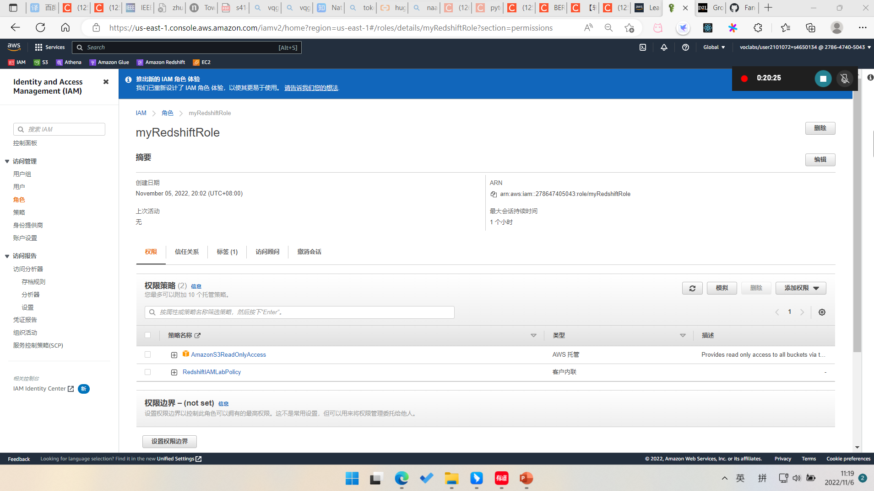
AWS Academy & MC & IAM Role

Slide 6
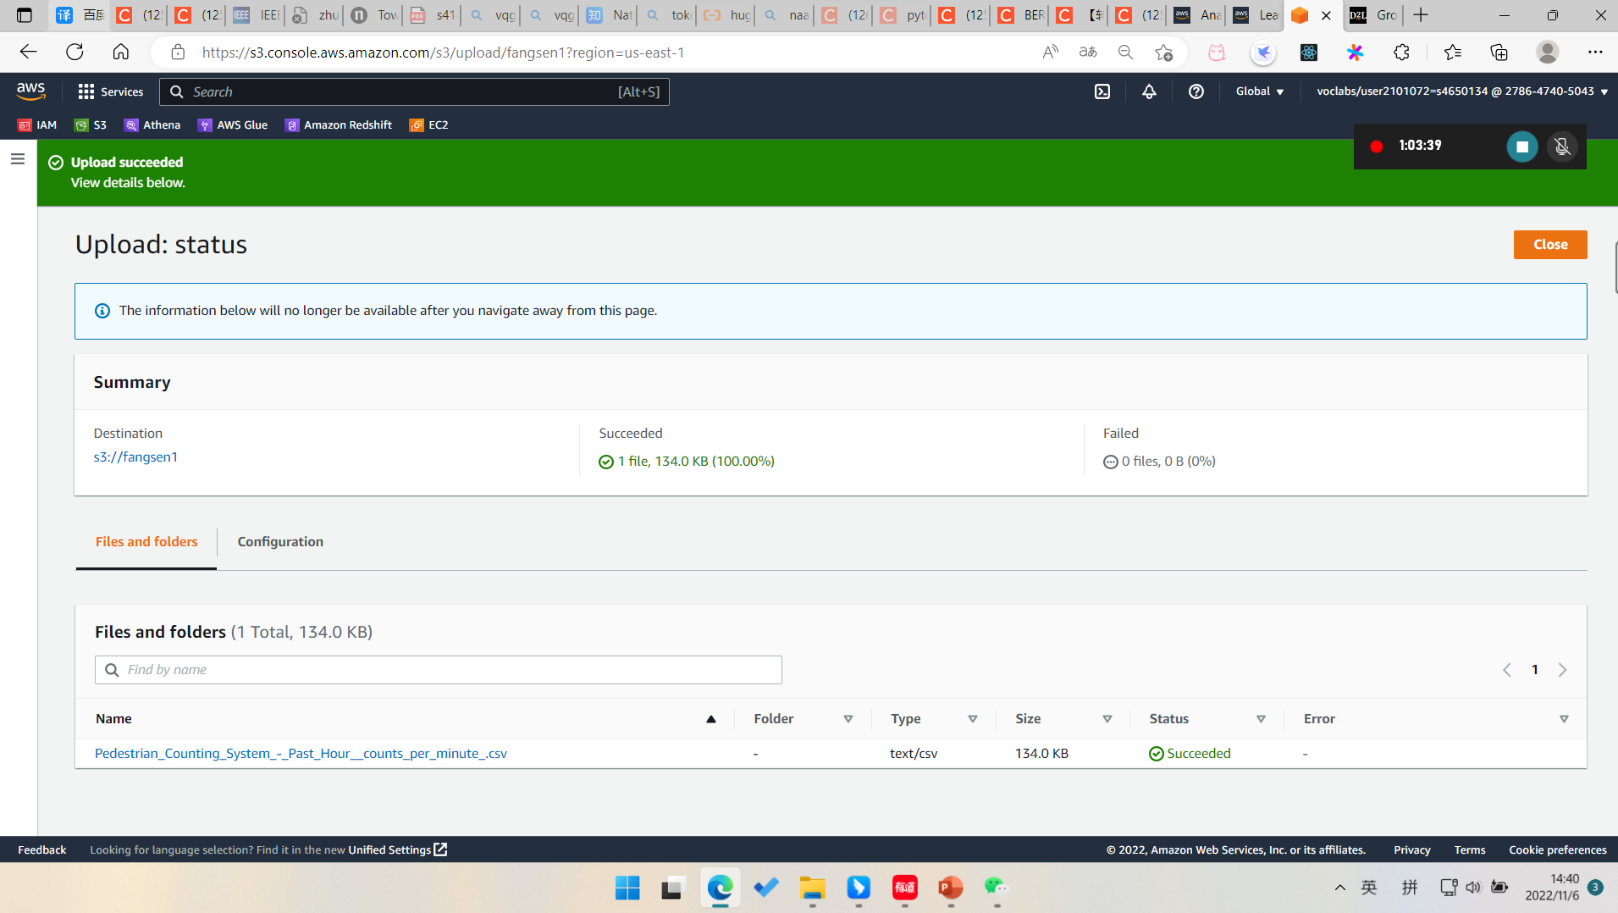
Data Storage – S3 bucket with file

Slide 7
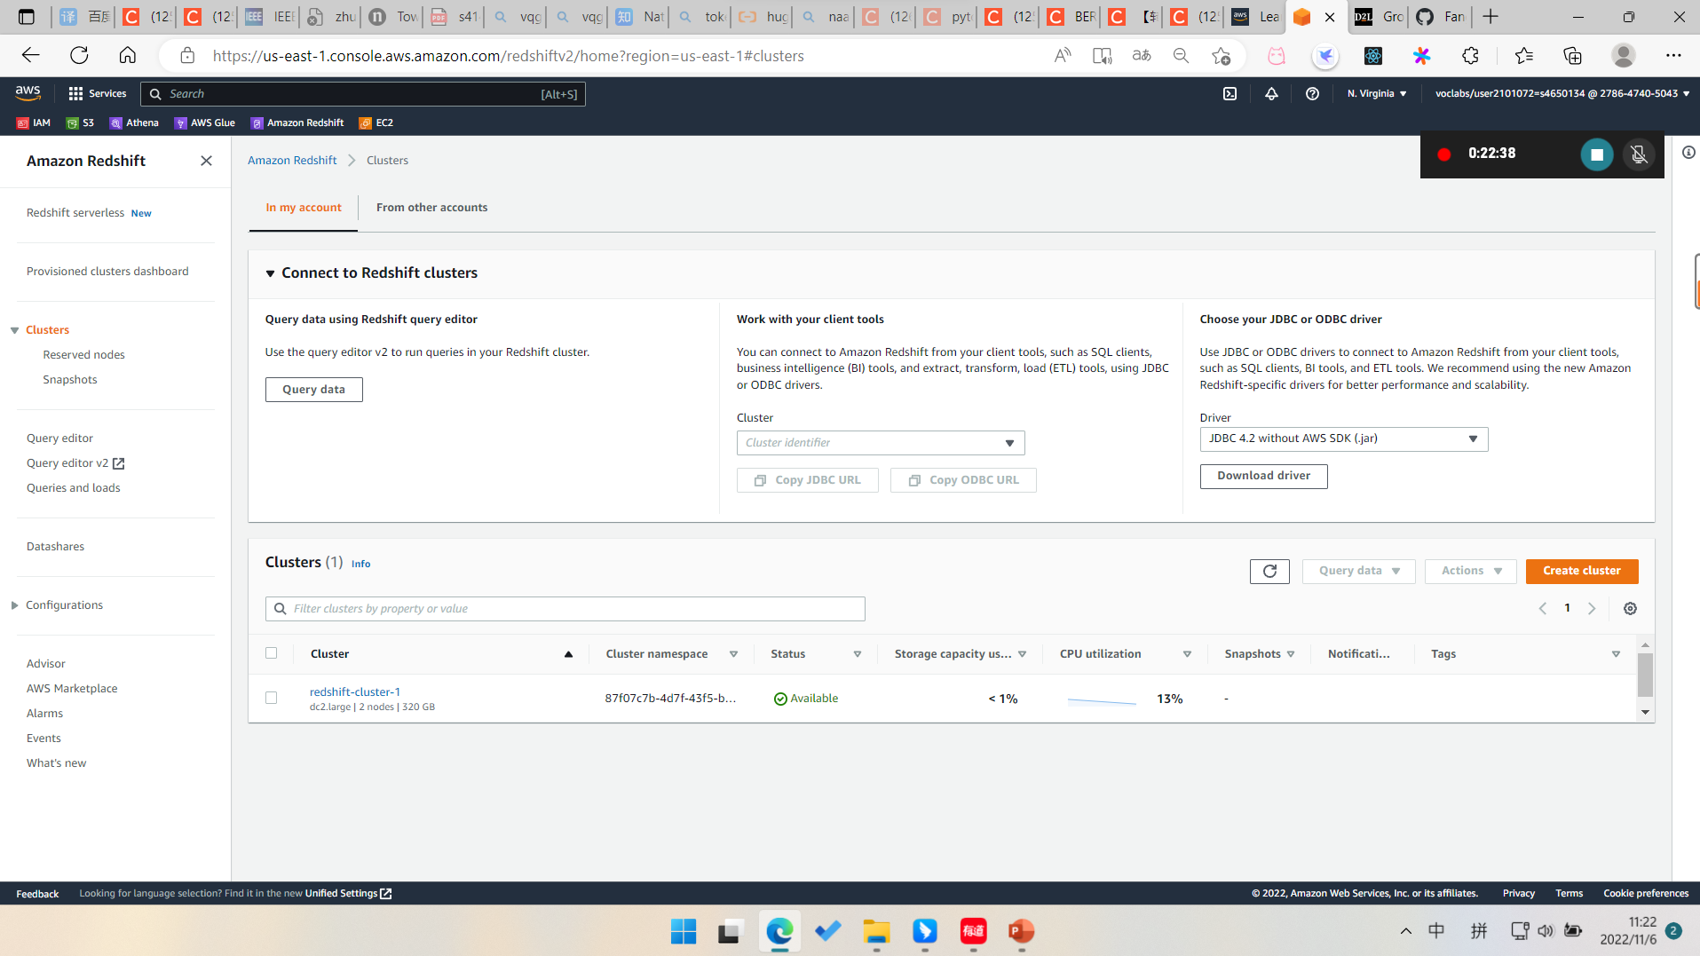
Data Warehouse – Redshift Settings

Slide 8
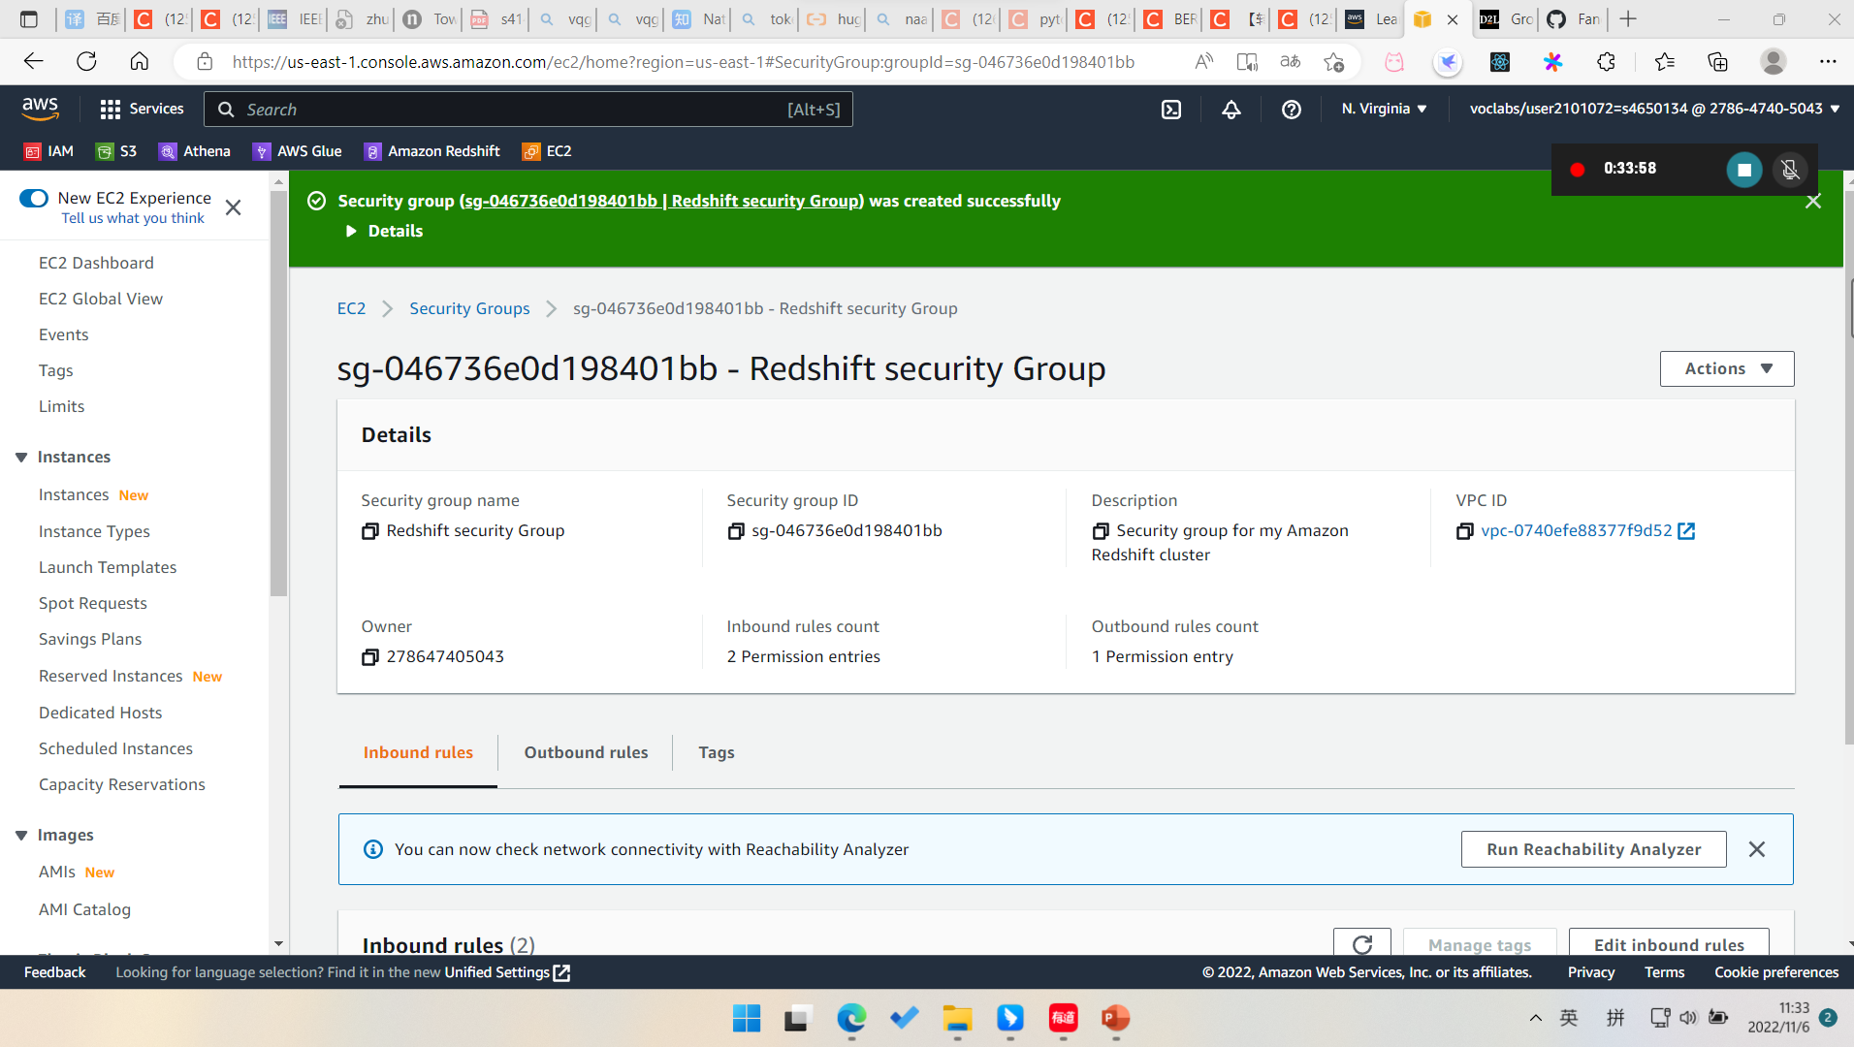
Redshift Cluster (Security Group)

Slide 9
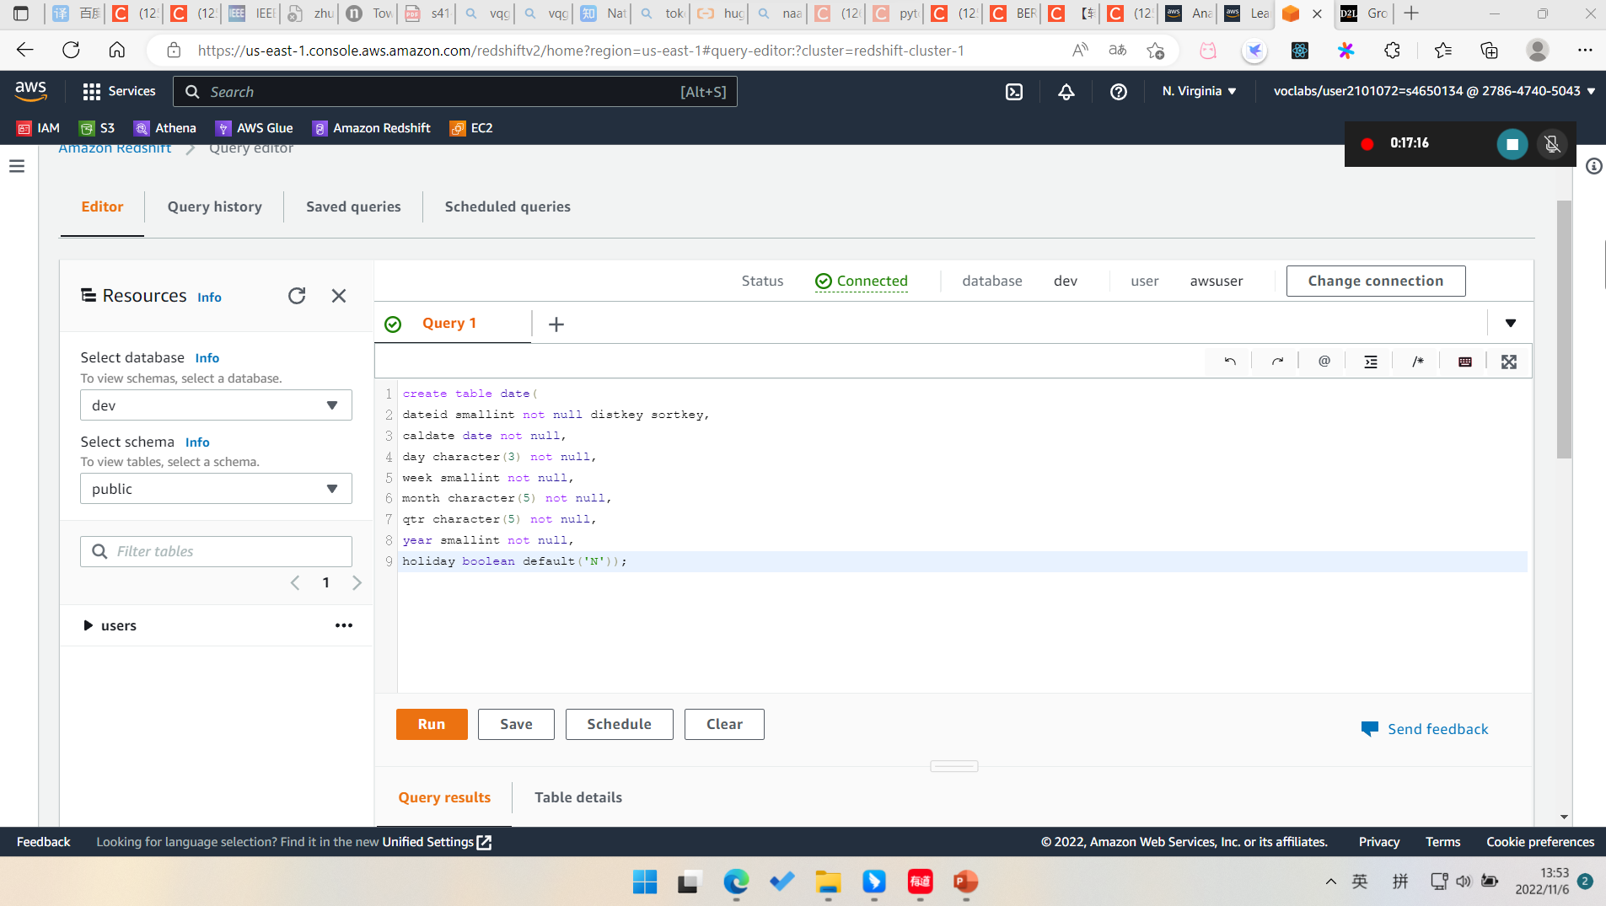
. Redshift Cluster (Create Table)

Slide 10
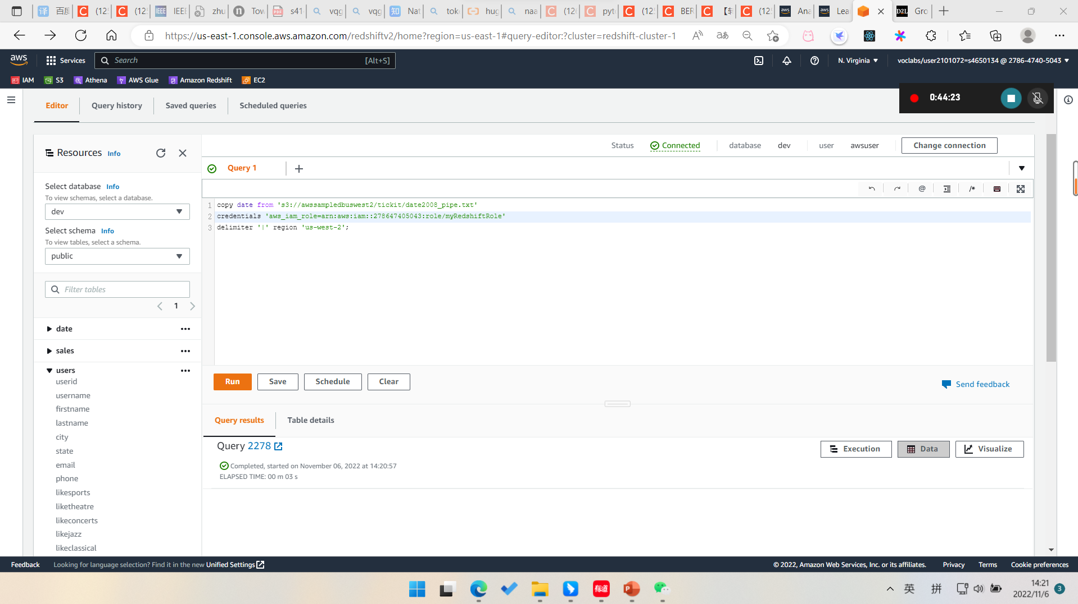
Redshift Cluster (Load Project Data)

Slide 11
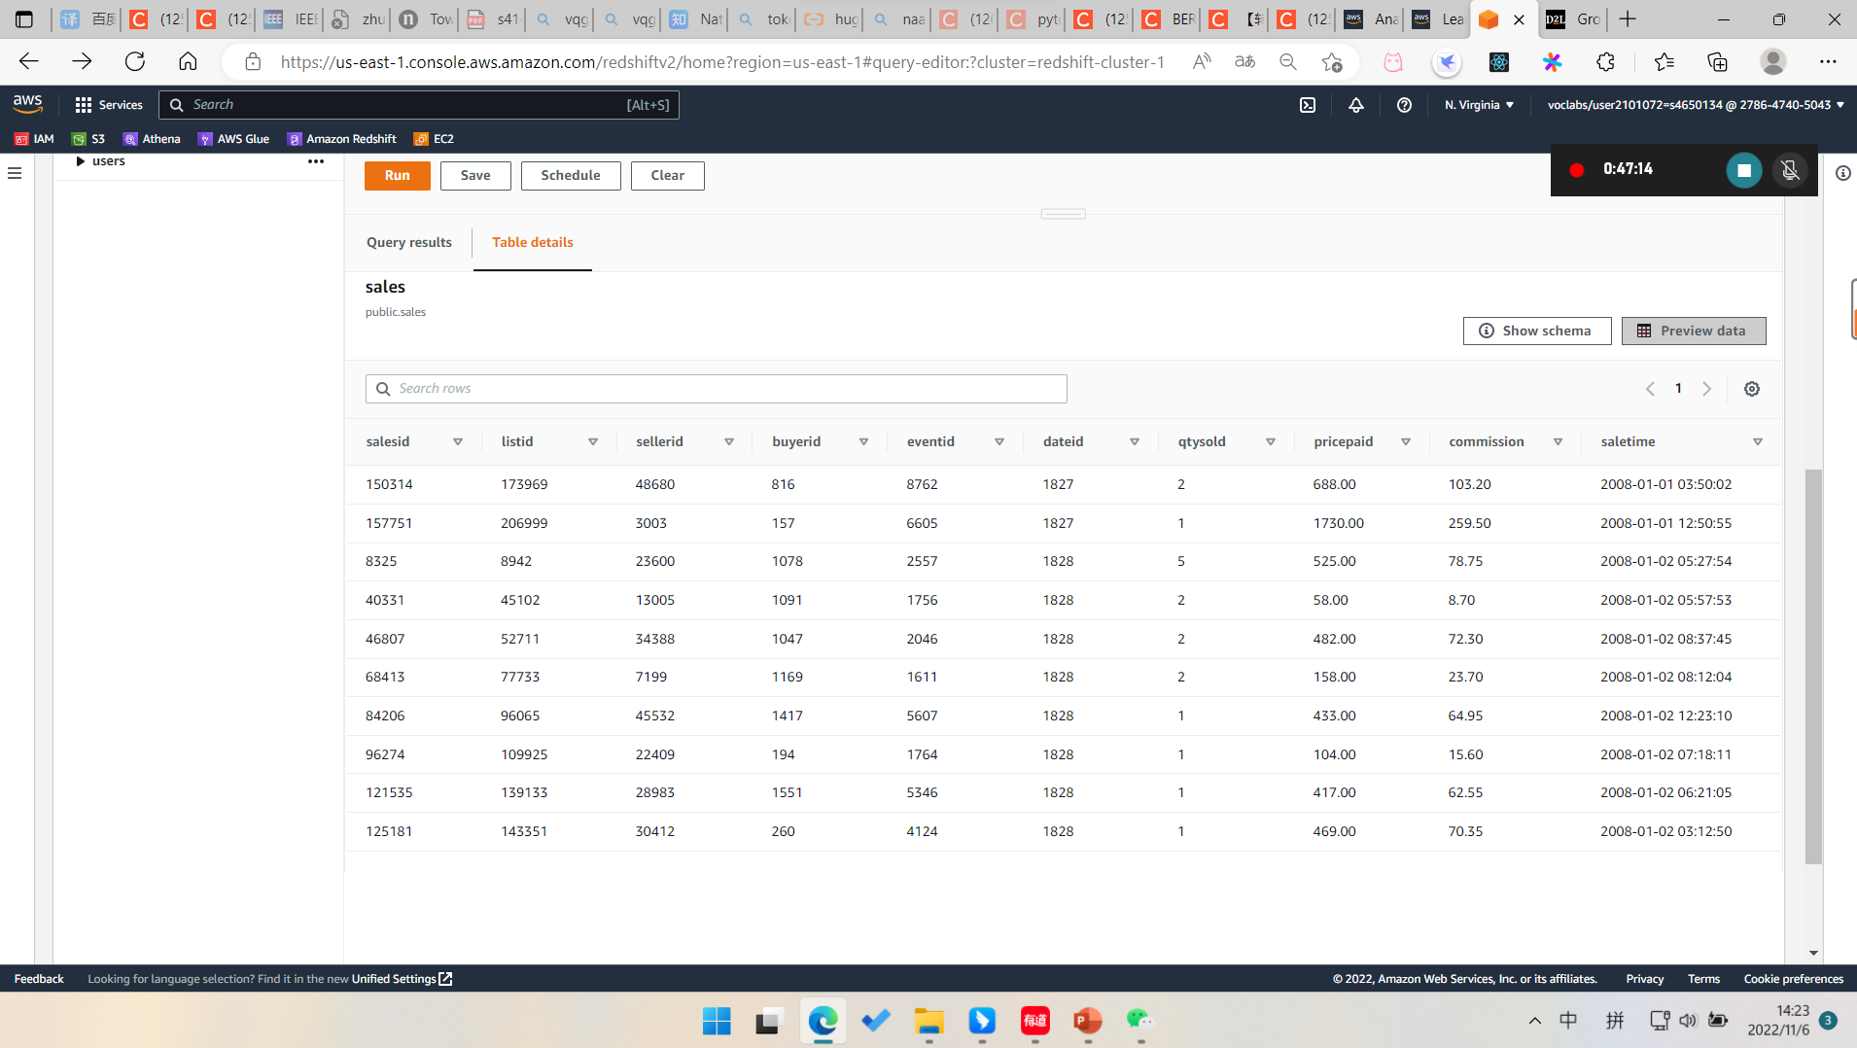
Redshift (Preview Data)

